Slide 1
SharePoint and Other Content Management Systems
Eleonora Babayants
Galaxy Consulting

Slide 2
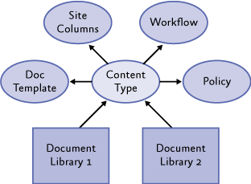
Content Types
A content type is a group of settings that describe the shared behavior of a specific group of documents.
Content types make it possible to organize and manage documents in a consistent way across a site.
Categorize your documents:
Document Type = Content Type
For example, SOPs, Work Instructions, White Papers, Articles.
In GMP environment, there are controlled documents. Content types are very useful to manage them.

Slide 3
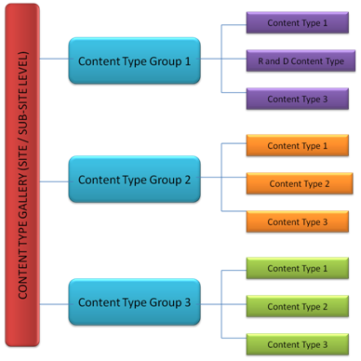
Content Types Hierarchy
Content types are organized into a hierarchy: parent and child content types.
Site content types ---> parent content types.
Library or list content types ---> child content types.
Site content type ---> metadata, workflows, policies.
Library content type ---> will inherit them.
Create libraries ---> select a site content type ---> all metadata, workflows, policies will be applied.
Change settings for many libraries ---> change the site content type.
Change settings for one library only ---> change that library settings only; it will not override the parent type.

Slide 4
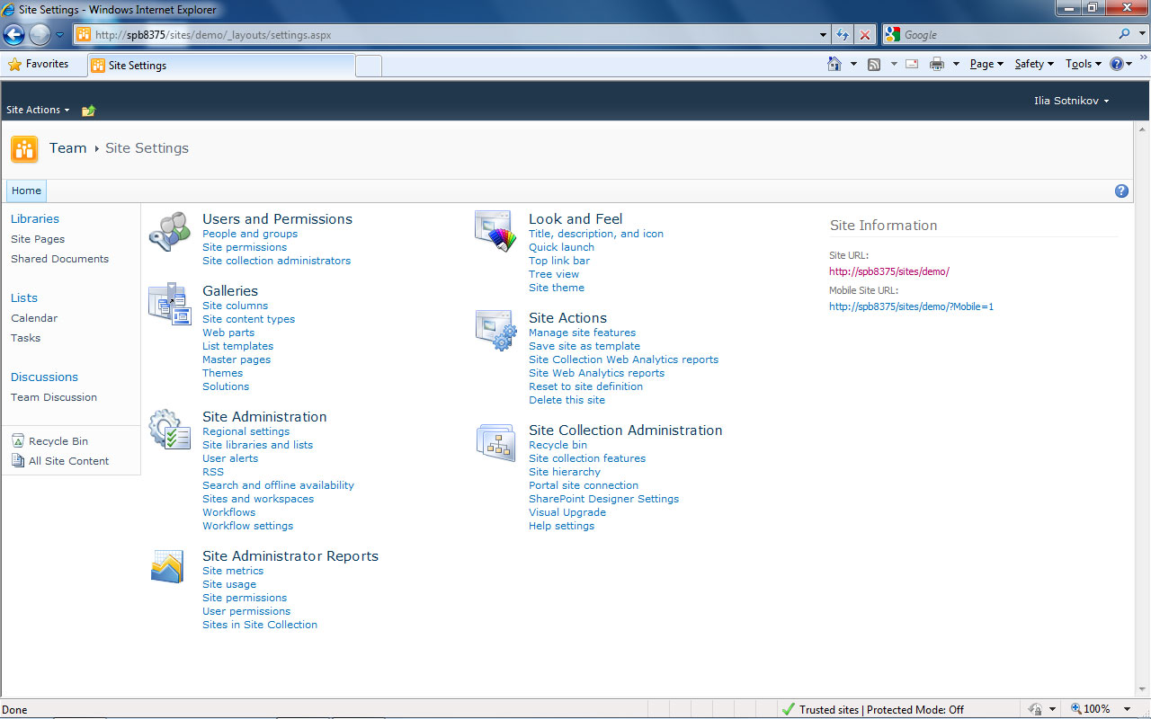

Slide 5
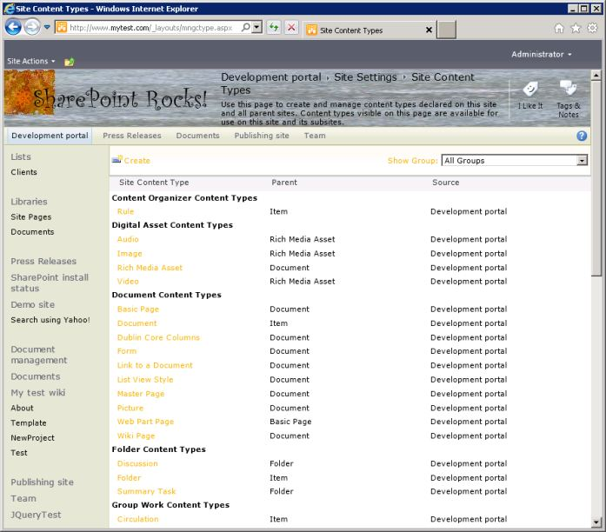

Slide 6
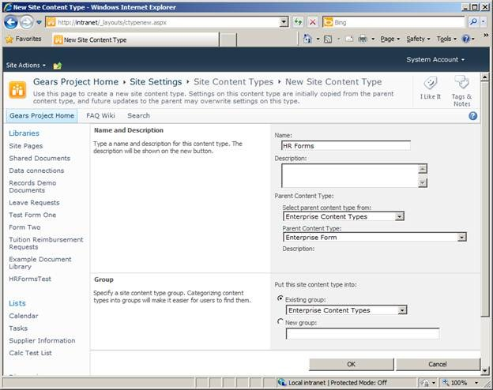

Slide 7
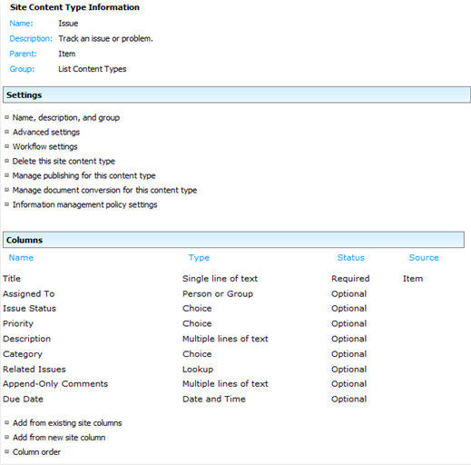

Slide 8
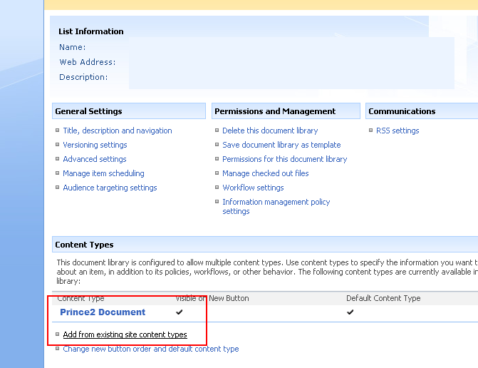

Slide 9
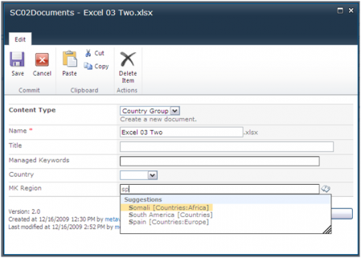

Slide 10
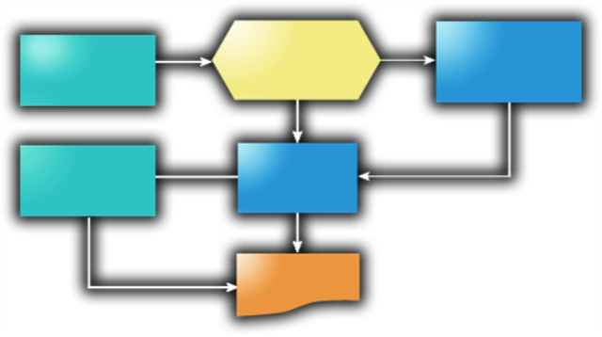
Workflows
Workflow is the automated movement of documents through a sequence of actions or tasks.
Workflows can streamline the cost and time required to coordinate business processes.
Set up workflows before they can be started – either in a content type or a library level.
Start a workflow at an item level.
Workflow status can be checked by users.
Workflow can be customized by users.
Workflows can be modified when in progress.
Types – approval, collect feedback, collect signatures, three-state.

Slide 11
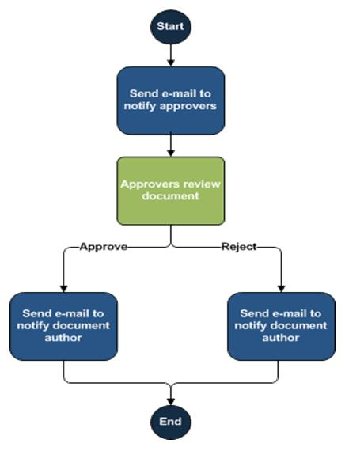
Workflow Types
Approval – routes a document to people for approval.
Example: controlled documents.
Collect Feedback – routes a document to people for feedback.
Collect Signatures – routes a document to people to collect their digital signatures.
Three-State – manages expiration and management of obsolete documents. This is especially important in the case of controlled documents.

Slide 13
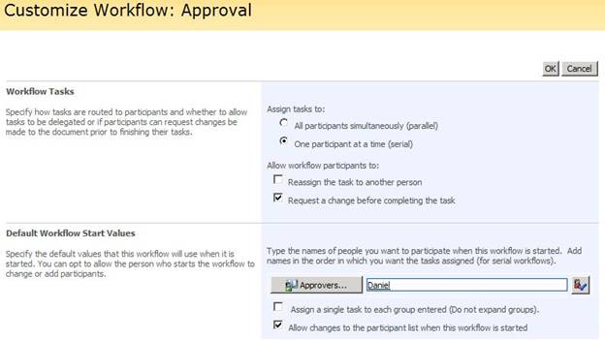

Slide 14
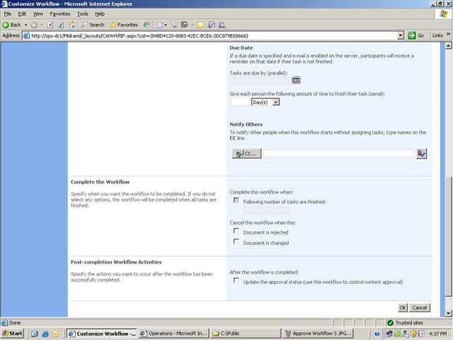

Slide 15
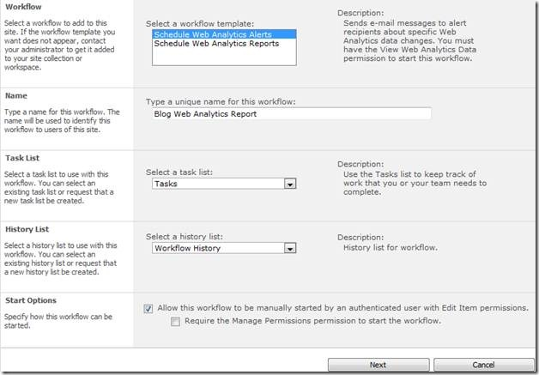

Slide 16
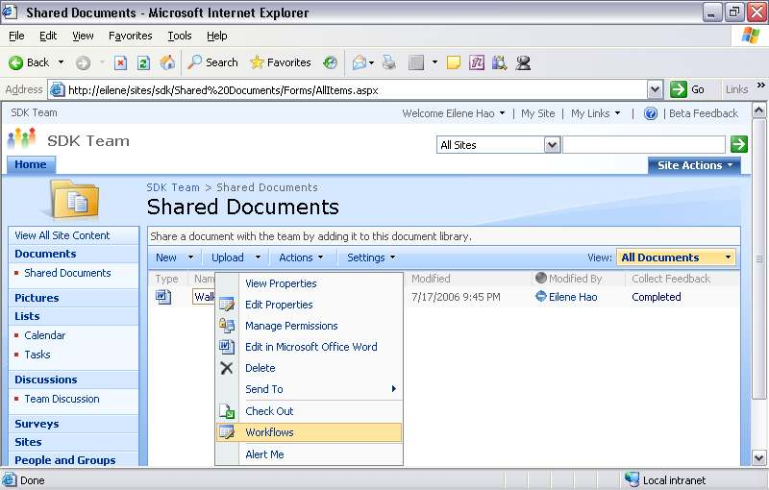

Slide 17
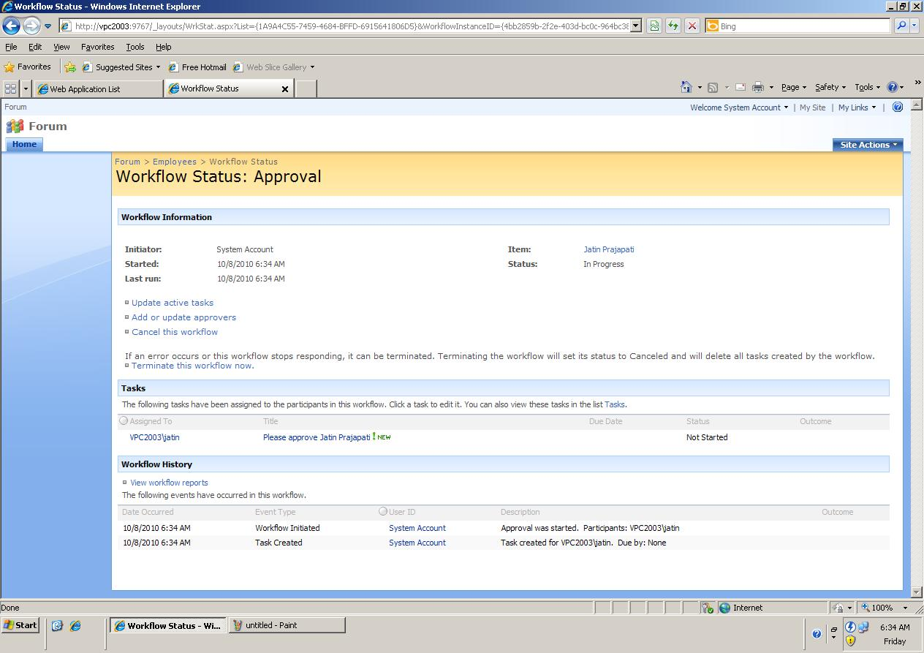

Slide 18
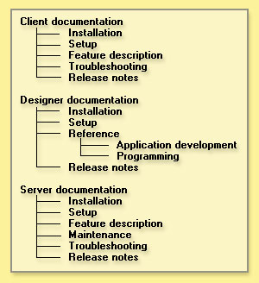
Taxonomy
Taxonomy is a hierarchical structure for the classification and organization of content.
Taxonomy is very important for SharePoint navigation and browsing.
Taxonomy development requires cooperation of departments.
Successful taxonomy – not too deep and not too wide.
There is no such thing as finished taxonomy.
Taxonomy in SharePoint is represented by sites, sub-sites, libraries, lists, and folders.
Create taxonomy before you start creating sites, sub-sites, libraries, lists, folders.
2010 version offers taxonomy management – taxonomy store – managed metadata service.

Slide 19
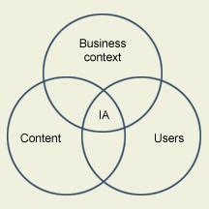
Taxonomy Factors
There are three key factors in taxonomy development: business context, content, and a user.
Business Context - What is the purpose of the taxonomy? How is the taxonomy going to be used?
Content - What is the content scope? Possibilities include companywide, within an organizational unit, etc.
What content sources will the taxonomy be built upon?
User - Who will be using the taxonomy? Possibilities include employees, customers, partners, etc. What are the user profiles?
Construct taxonomy with users feedback.

Slide 20
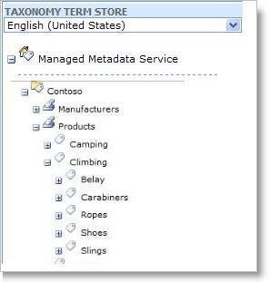

Slide 21

Search
Full text search – quick search.
Full text search – advanced search.
Create a site “advanced search”, edit the web part to update metadata.
The crawler and metadata have to be configured on the server administration level.
Limit search results by site.
Limit search results - metadata search.

Slide 22

Search 2010
Search significantly improved in 2010 version.
People and experience search:
dedicated ranking system based on My Site;
phonetic and nickname search – Geoff and Jeff;
keyword and colleague mining – extracts information from messages in Outlook.
Content search:
metadata refinement – faceted search;
click through relevancy – based on users clicking for similar queries;
taxonomy tag integration;
advanced content processing – extract and create metadata to improve search results;
contextual search – refinement based on the user profile;
thumbnails and previews.

Slide 23
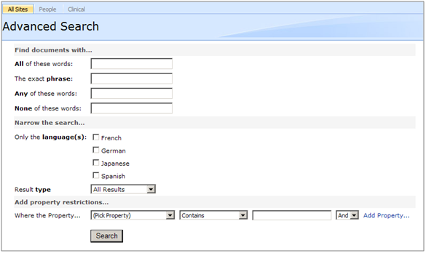

Slide 24
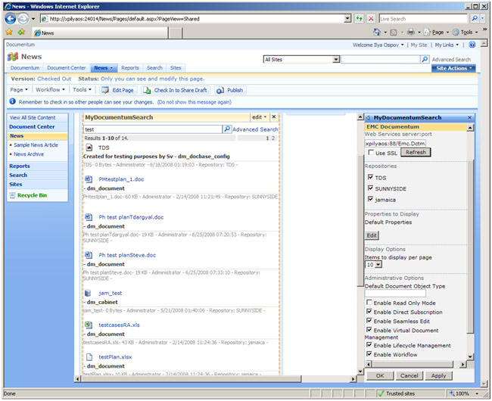

Slide 25
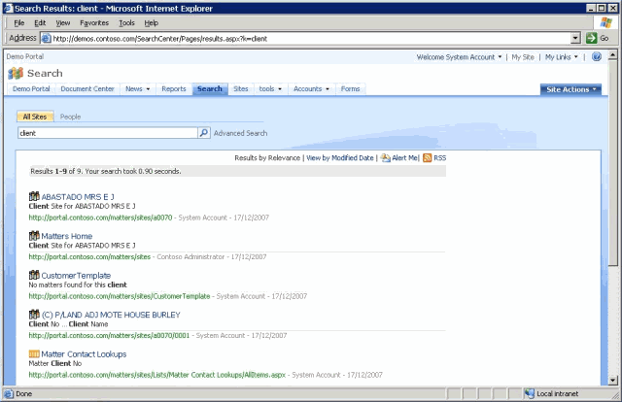

Slide 26
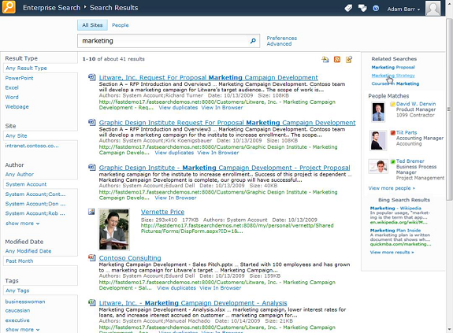

Slide 27
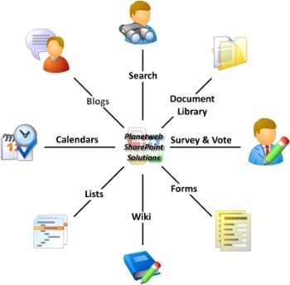
Collaboration
Wiki – quickly capture and share ideas by creating simple pages with links that anybody can edit. Great tool for brainstorming!
Blog – web site that enables to share the information. Contains dated posts in chronological order and comments.
Discussion Boards – to share information and discuss topics with other people.
My Site – is a personal site that gives you a central location to manage and store your documents, content, links, and contacts.

Slide 28
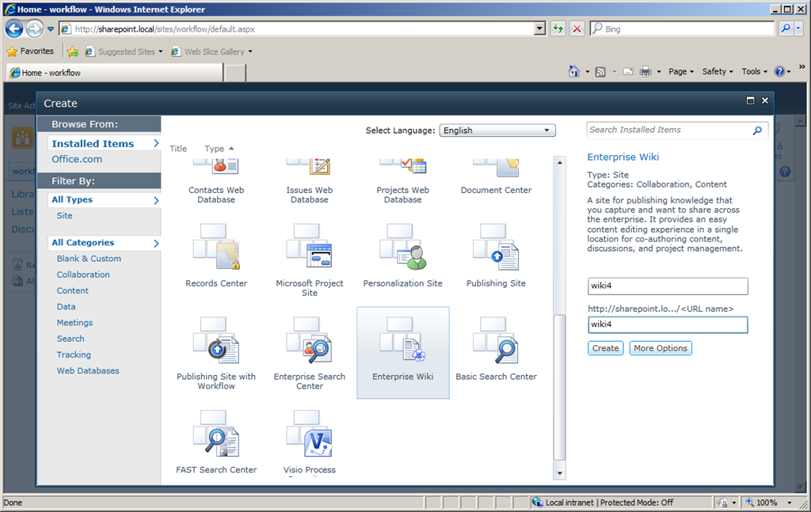

Slide 29
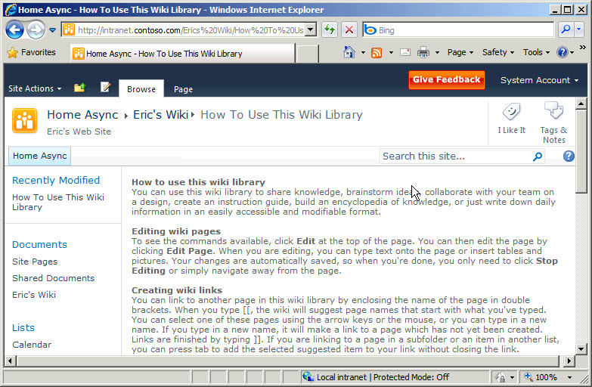

Slide 30
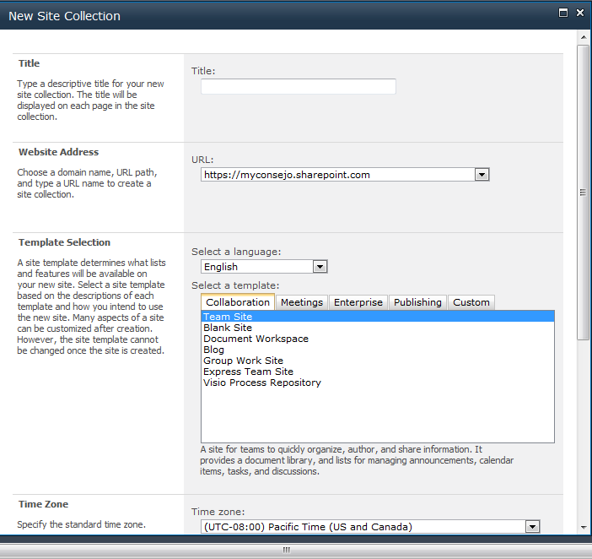

Slide 31
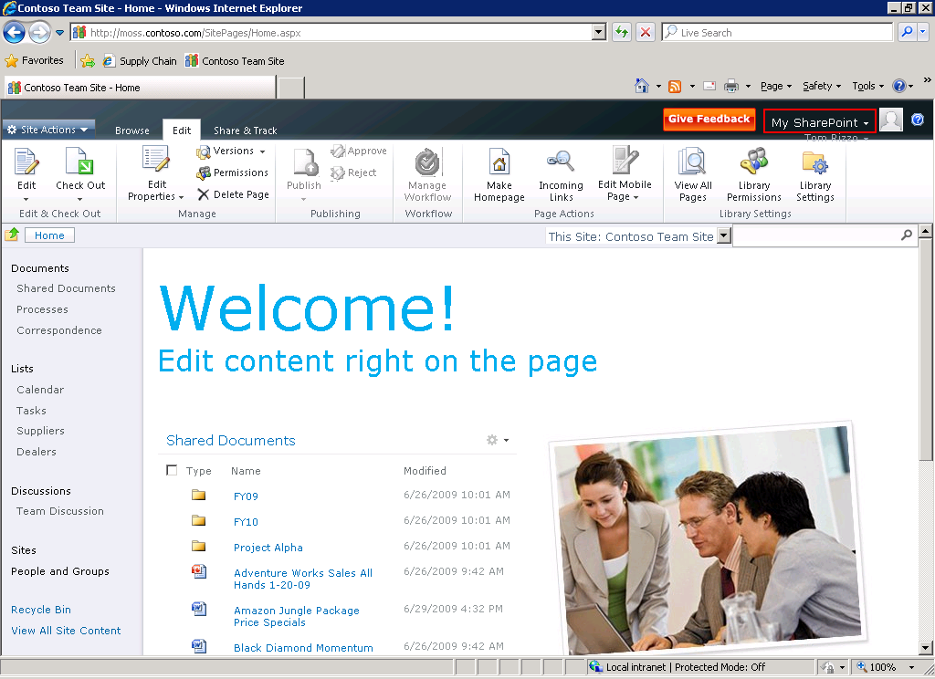

Slide 32
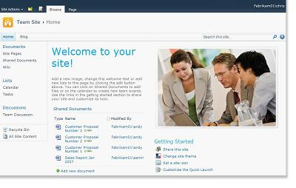

Slide 33

Business Solutions
Electronic Forms – can create forms using InfoPath.
Project Management – the site that allows to track project tasks.
Issues Tracking – list to track issues.
Surveys – can create and send surveys.
Dashboards – to display business data and reports.

Slide 34
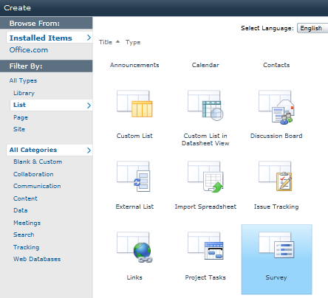

Slide 35
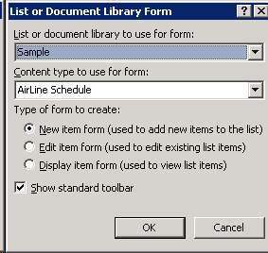

Slide 36
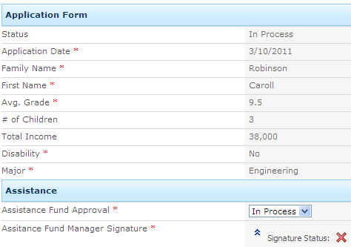

Slide 37
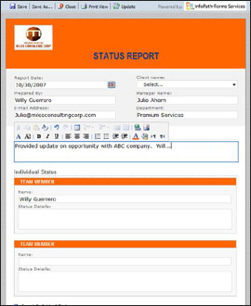

Slide 38
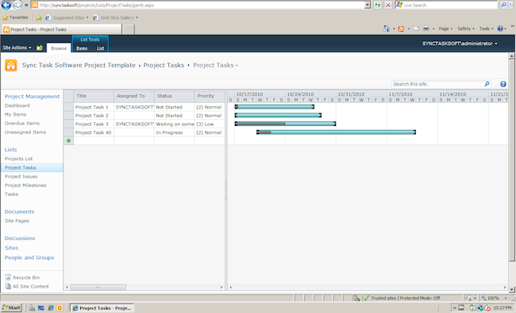

Slide 39
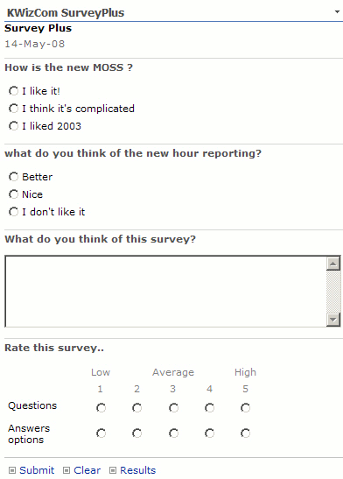

Slide 40
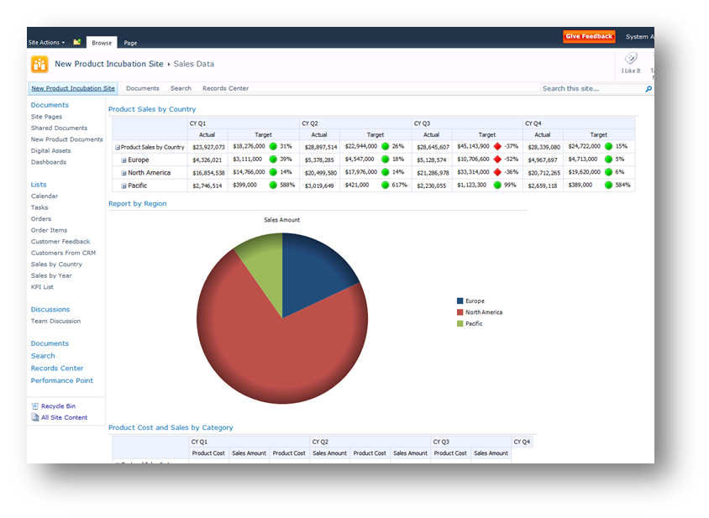

Slide 41
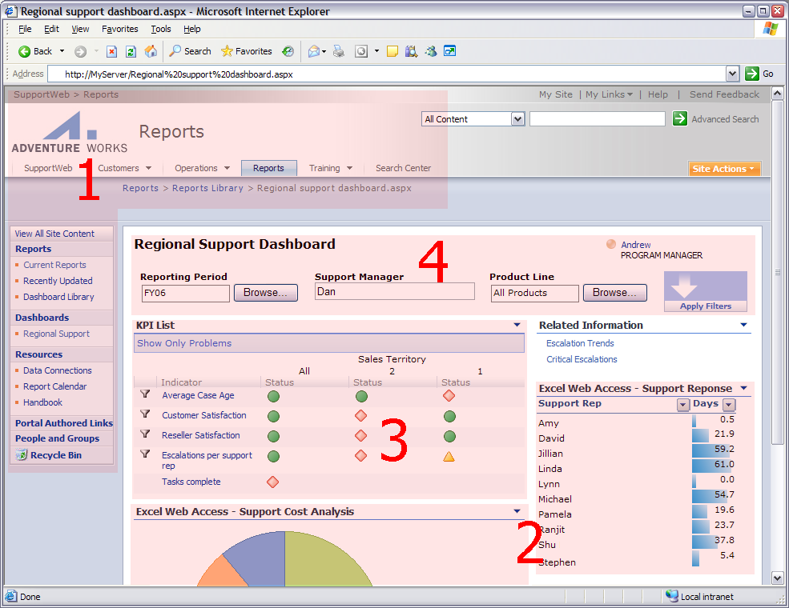

Slide 42
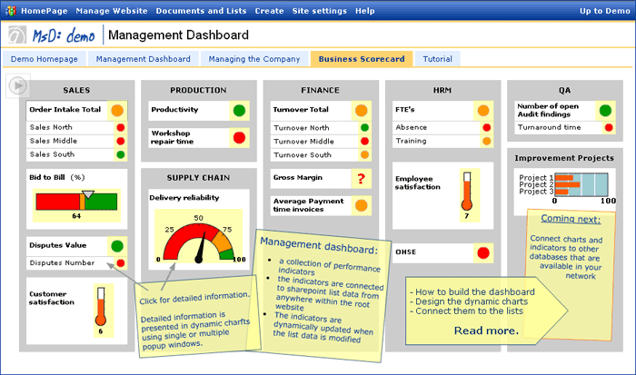

Slide 43
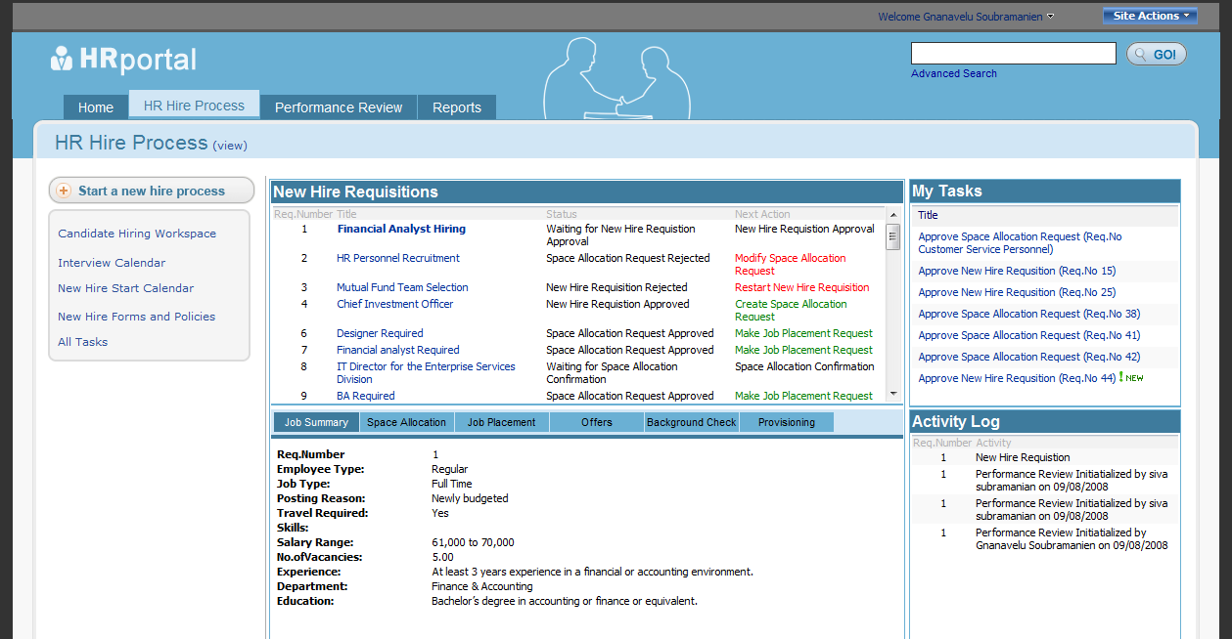

Slide 44
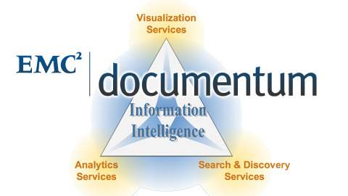
Other CMS - Documentum
Produced by EMC and includes:
Content Security - secure access to sensitive information:
Documentum Information Rights Management
Documentum IRM Client for E-Mail
Documentum IRM Client for Microsoft Office
Documentum IRM Client for PDF
Documentum Trusted Content Services
Digital Asset Management - for managing digital assets;
Records Management - to control records lifecycle:
Documentum Federated Records Services
Documentum Physical Records Services
Documentum Records Manager
Documentum Retention Policy Services

Slide 45

Other CMS - Documentum
Documentum Standard - to organize and control enterprise content;
Documentum CenterStage
Documentum eRoom - online team collaboration
Documentum Platform – includes XML component management
Documentum Platform Extensions
Documentum Repository Services for SharePoint - you can redirect content normally destined for SharePoint’s and send it to a Documentum repository.
Documentum Webtop
Documentum xDB

Slide 46
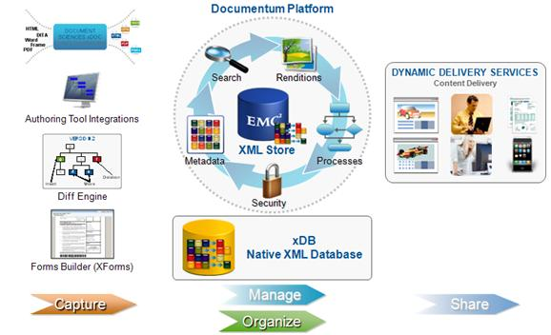
Other CMS - Documentum
Documemtum xCP – high performance platform to organize and control enterprise content:
Documentum Platform
Documentum Platform Extensions
Documentum xCP Designer
Documentum xCP for Business Process Management
Documentum xCP Process Analyzer
Documentum xCP xCelerators

Slide 47
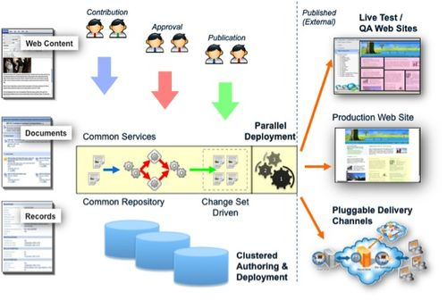
Other CMS - TeamSite
Produced by Interwoven, acquired by Autonomy, then by HP.
It is a component CMS - manages content at a component level rather than at the document level. It includes:
ContentCenter Standard - portal with easy interface;
ContentCenter Professional - portal with advanced interface for content contribution and management;
FormsPublisher - for structured, form-based content authoring;
SitePublisher - a WYSIWYG content contribution interface with a reusable component based architecture;
MediaBin Digital Asset Management Server - for rich media asset management;
MetaTagger - content intelligence services for automated metadata extraction and recommendation.

Slide 48
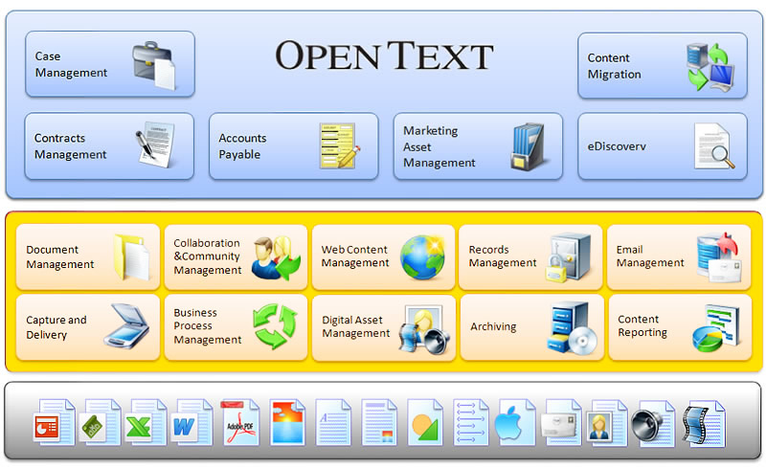
Other CMS – Open Text ECM Suite
Open Text ECM suite:
Document management - formerly Livelink - provides full lifecycle management for documents;
Digital asset management
Records management - managing the retention and disposition of records – complies with FDA regulations;
Web content management – for web content applications; includes portal;
eDocs – formerly Hummingbird
- for managing all forms of content; also includes collaboration, forums, blogs, wikis, instant messaging, and provides business process management tools.

Slide 49

Other CMS – Oracle UCM
Formerly Stellent – is a component CMS, supports entire content lifecycle.
Includes:
web content management;
document management;
digital asset management;
records and retention management;
personalized content delivery;
categorization;
portal integration;
SharePoint integration;
document capture and scanning integration;
content conversion and transformation.

Slide 50
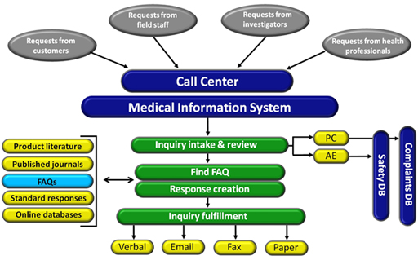
Information Request Management System (IRMS)
Medical information software – produced by OBA - for handling medical communications; allows to record requests for information and responses;
utilizing a shared database (Oracle, SQL, MS Access) to store request data and standard response documents;
includes FAQ management, contact management, content management, adverse events, product complaints modules;
integrates with Siebel for CRM and Documentum for document management;
FDA and CFR 21 compliant and validated;
hosting services are available.

Slide 51
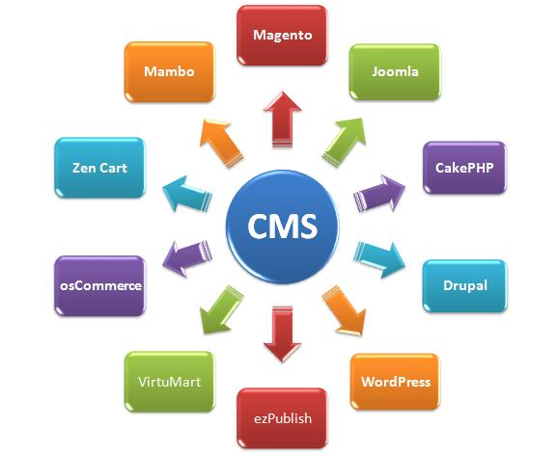
Other CMS – Open Source
Open Source free CMS:
Drupal – used for web sites, knowledge management and collaboration.
Joomla – used for publishing content on the web and intranet.
Alfresco – enterprise content management system, includes: document management, web content management system, records management, content platform, collaboration.

Slide 52

Eleonora Babayants, MLS
Email: eleonora.babayants@gmail.com Office: 650-474-0955
www.galaxyconsulting.weebly.com
Twitter: GalaxyConsult
Blog: galaxyconsulting.blogspot.com

